Slide 1





Network Structure and Group Size Impact Adoption of Norms
Julian Kohne , Natalie Gallagher, Z. M. Kirgil, Rocco Paolillo, Lars Padmos,
GESIS
Northwestern Uni.
Uni. Of Groningen
Bremen Uni.
Uni. Of Groningen
Fariba Karimi
Department of Computational Social Science
GESIS Institute, Germany

Slide 2
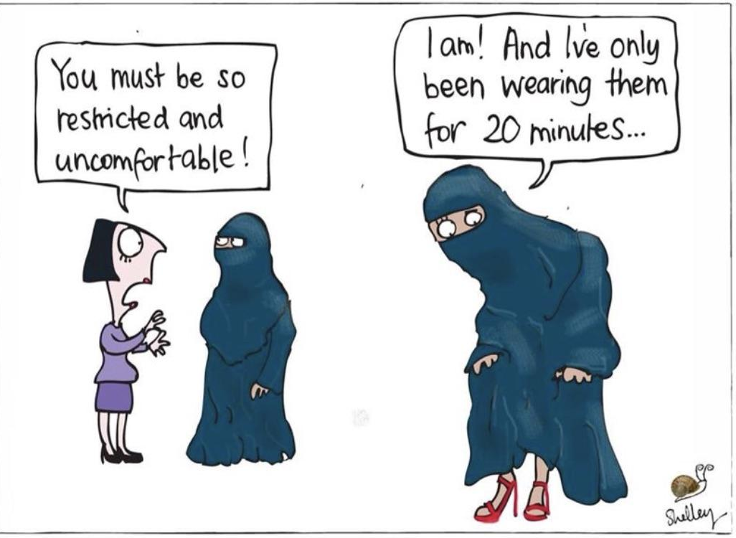
Notes:
Social norms can facilitate societal coexistence in groups by providing ashared set of expectations and behavioral guidelines. However, different social groups can hold different norms, and lacking a normative consensus can lead to conflict within and between groups
In France, lawmakers claimed that a burqa ban was necessary to ensure “peaceful cohabitation” (Zeit Online 2019)
This backlash reflects an underlying normative conflict, with a large majority (81%) of Germans supporting a ban in public institutions ,
In essence, inconsistent social norms within a larger collective have the potential to lead to intergroup, as well as intragroup conflict.

Slide 3
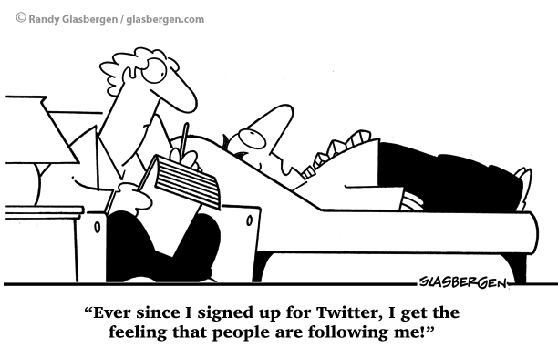
Social Influence Operates through Social Interactions
Notes:
Individuals do not adopt norms in isolation; the structure of their social network
is a key role for this social behavior. The social networks in which we are
embedded determine the kinds of people and behavior to which we are exposed,
thereby shaping the norms we hold.
With respect to increasing trend of globalization and migration, social groups and individuals with different norms i interact with each other, creating potential for normative conflict.
So in this research we aim to undrestand the role of network structure

Slide 4
How do the network strcture (homophily) and minority size impact the adoption of norms among minority and majortiy.
Notes:
So in this research we aim to undrestand the role of network structure …

Slide 5
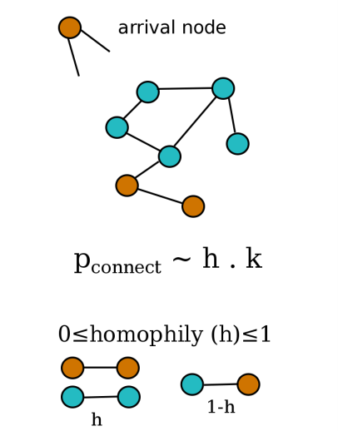
Network Growth Model with tunable homophily and group size
2 group of nodes with unequal size
Arrival node connects to existing nodes based on preferential attachment (k) and homophily (h)
Karimi et al Sci Rep 2018
Notes:
First, we make simple network models as a thought experiment to generate worlds with tunable homophily and group size. We propose a network model that enables us to tune the homophily and group size to study the impact of these two parameters on the ranking and visibility of nodes. Creating thought experiments to understand different worlds
5

Slide 6
High Heterophily
Majority illusion
High Homophily
Filter bubble
h = 0
h = 1
Homophily
Karimi et al Sci Rep 2018
Karimi*, Lee* et al Nature Human Behaviour 2019
Notes:
Using empirical data analysis and computer simulations, we found evidence that homophily create more invisibility and low ranking for minorities.

Slide 7
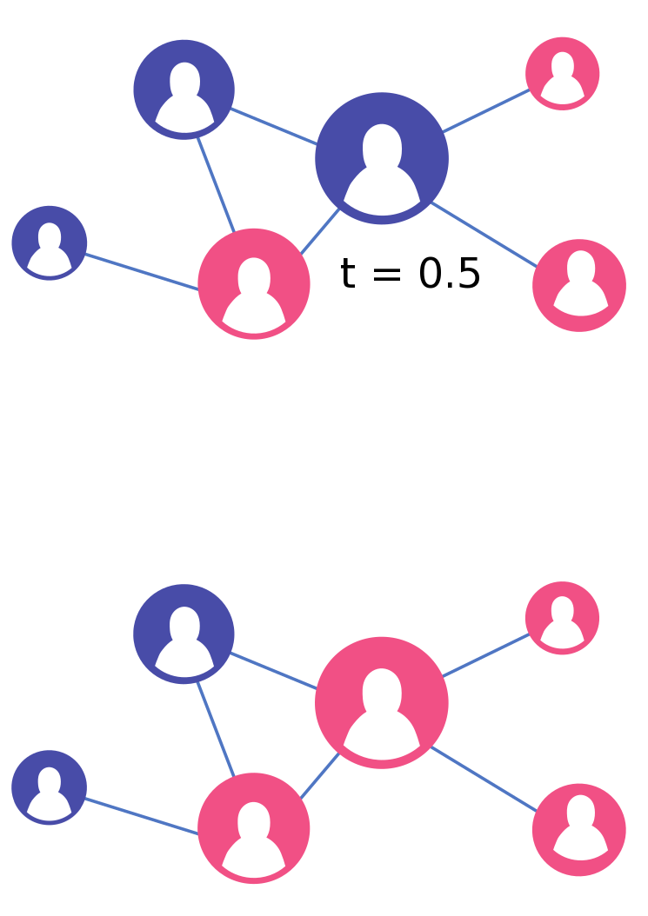
Granovetter Threshold Model
Granovetter. American Journal of Sociology (1978)
Notes:
Granovetter. American Journal of Sociology (1978)

Slide 8
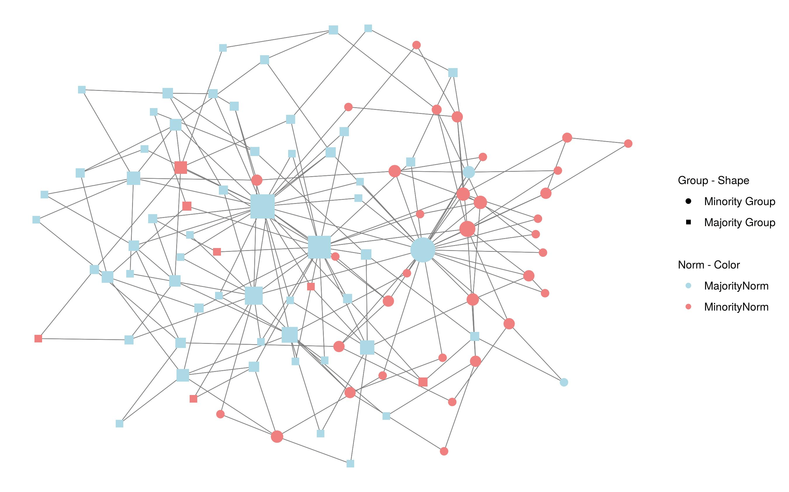
Video: Norm change over time
Notes:
For example, majority (rectangulars) are more likely to hold the blue norm and minorities are more likely to hold the red norms.
h = 0.85 g = 0.3 m = iter= 50 norm_end_maj = 0.9 norm_end_min = 0.1

Slide 9
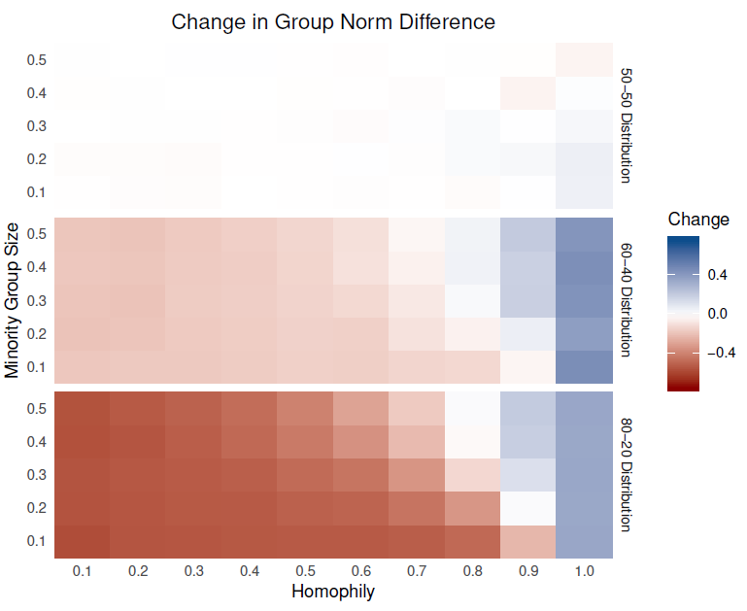
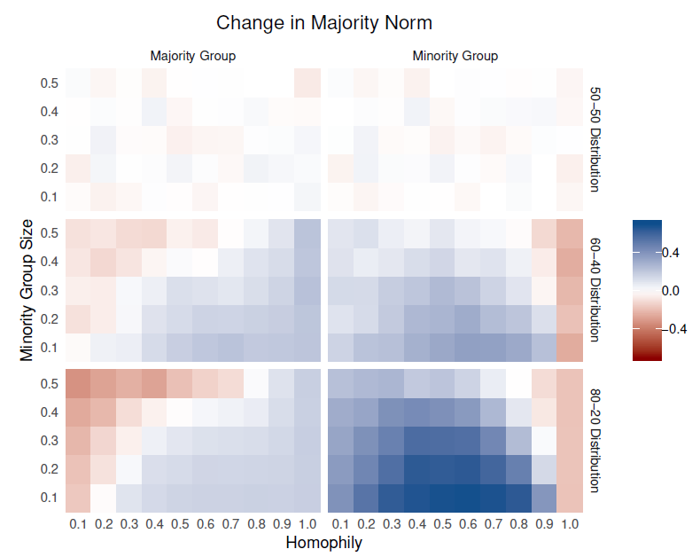
Change in group norm difference
More different
Minority fraction
More similar
- Mutual conformity is difficult to achieve when minority group is large.
- Low homophily/ high heterophily result in mutual conformity.
Notes:
But which groups are sacrificing their norms?

Slide 10
Change in Norm Adoption
Shift towards majority norm
Majority group
Minority group
Minority fraction
Shift towards minority norm
Initial norm distribution: 80-20
- When network is heterophilic, majority adopt the minority norm
- In intermediate range of homophily, minority adopt the majority norm.
- When network is highly homopilic, groups stick to their norms.
Notes:
Non-linear behaviour in the lowe and intermediate range of homopihly
Applications in understanding the obstacles that immigrants face in terms of integration in society. How much integration should be imposed in order for peaceful coexistence of groups.

Slide 11

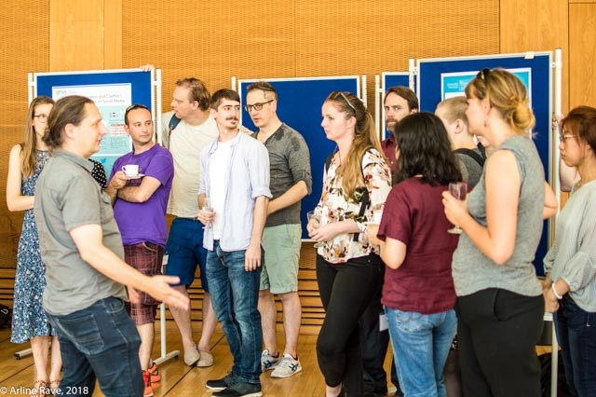

Thank you for your attention!
Link: arXiv:1907.00888
github: gesiscss/SimulatingNormativeConflict
Special thanks to BIGSSS summer school in CSS (check 2020 edition)

